Slide 1
Data Science Capstone Project
Mathew Romy
Github link:https://github.com/mathhewRomy/IBM_Data_Science

Slide 2
OUTLINE
Executive Summary
Introduction
Methodology
Results
Conclusion
Appendix

Slide 3
Executive Summary
Collected data from SpaceX API and SpaceX Wikipedia page. Explored data using SQL, visualization, folium maps, and dashboards. Gathered relevant columns to be used as features. Changed all categorical variables to binary using encoding. Standardized data and used GridSearchCV to find best parameters for machine learning models. Visualize accuracy score of all models
Machine learning models like Logistic Regression, Support Vector Machine, Decision Tree Classifier, and K Nearest Neighbors are used and an accuracy of 83.33%

Slide 4
Introduction
SpaceX offers services with relatively lower costs.
Due to the ability of SpaceX to recover part of the rocket.
Problem
Space Y wants to train a machine learning model to predict successful Stage 1 recovery

Slide 5
Methodology
Data collection methodology:
data from SpaceX public API and SpaceX Wikipedia page
Perform data wrangling
Classifying true landings as successful and unsuccessful if false
Perform exploratory data analysis (EDA) using visualization and SQL
Perform interactive visual analytics using Folium and Plotly Dash
Perform predictive analysis using classification models
Tuned models using GridSearchCV

Slide 6
Data Collection - Using API
Steps
Request data from SpaceX API (rocket launch data)
Decode response using .json() and convert to a dataframe using .json_normalize()
Request information about the launches from SpaceX API using custom functions
Create dictionary from the data
Create dataframe from the dictionary
Filter dataframe to contain only Falcon 9 launches
Replace missing values of Payload Mass with calculated .mean()
Export data to csv file

Slide 7
Data Collection - Using WebScraping
Steps
Request data (Falcon 9 launch data) from Wikipedia
Create BeautifulSoup object from HTML response
Extract column names from HTML table header
Collect data from parsing HTML tables
Create dictionary from the data
Create dataframe from the dictionary
Export data to csv file

Slide 8
Data Wrangling
False Ocean: represented an unsuccessful landing to a specific region of ocean
True RTLS: meant the mission had a successful landing on a ground pad
False RTLS: represented an unsuccessful landing on a ground pad
True ASDS: meant the mission outcome had a successful landing on a drone ship
False ASDS: represented an unsuccessful landing on drone ship
Outcomes converted into 1 for a successful landing and 0 for an unsuccessful landing

Slide 9
EDA with Visualization
Charts
Flight Number vs. Payload
Flight Number vs. Launch Site
Payload Mass (kg) vs. Launch Site
Payload Mass (kg) vs. Orbit type

Slide 10
EDA with SQL
Loaded data set into IBM DB2 Database.
Queried using SQL Python integration.
Queries were made to get a better understanding of the dataset.
Queried information about launch site names, mission outcomes, various pay load sizes of customers and booster versions, and landing outcomes

Slide 11
Data Visualizations
Map with Folium
Markers Indicating Launch Sites
Added blue circle at NASA Johnson Space Center's coordinate with a popup label showing its name using its latitude and longitude coordinates
Added red circles at all launch sites coordinates with a popup label showing its name using its name using its latitude and longitude coordinates Map with Folium
Colored Markers of Launch Outcomes
Added colored markers of successful (green) and unsuccessful (red) launches at each launch site to show which launch sites have high success rates
Distances Between a Launch Site to Proximities
Added colored lines to show distance between launch site CCAFS SLC40 and its proximity to the nearest coastline, railway, highway, and city

Slide 12
Data Visualizations
Dashboard with Plotly Dash
Dropdown List with Launch Sites
Allow user to select all launch sites or a certain launch site
Pie Chart Showing Successful Launches
Allow user to see successful and unsuccessful launches as a percent of the total
Slider of Payload Mass Range
Allow user to select payload mass range
Scatter Chart Showing Payload Mass vs. Success Rate by Booster Version
Allow user to see the correlation between Payload and Launch Success

Slide 13
Predictive Analysis
Charts
Create NumPy array from the Class column
Standardize the data with StandardScaler. Fit and transform the data.
Split the data using train_test_split
Create a GridSearchCV object with cv=10 for parameter optimization
Apply GridSearchCV on different algorithms: logistic regression (LogisticRegression()), support vector machine (SVC()), decision tree (DecisionTreeClassifier()), K-Nearest Neighbor (KNeighborsClassifier())
Calculate accuracy on the test data using .score() for all models
Assess the confusion matrix for all models
Identify the best model using Jaccard_Score, F1_Score and Accuracy

Slide 14
EDA with Visualization

Slide 15
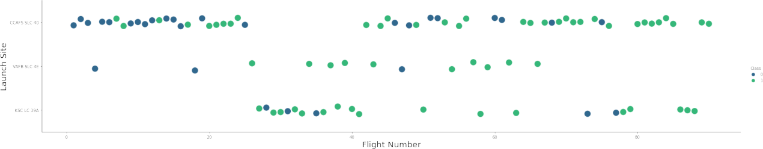
Flight Number vs. Launch Site

Slide 16
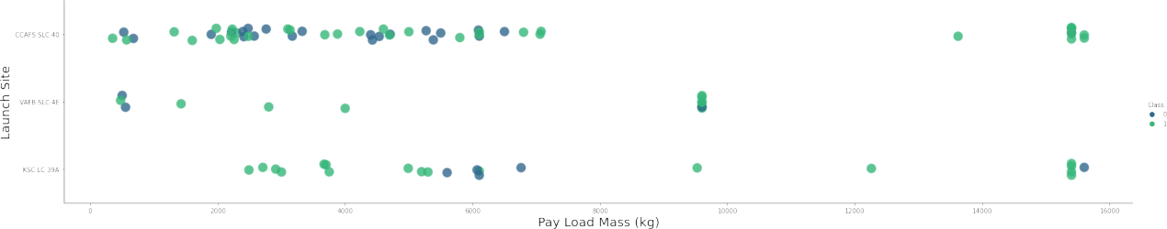
Payload vs. Launch Site

Slide 17
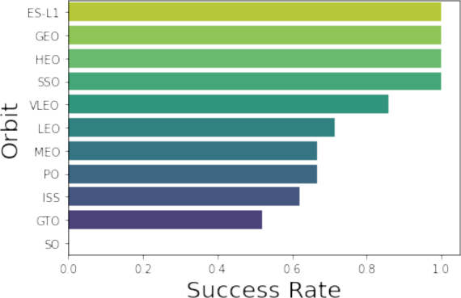
Success rate vs. Orbit type

Slide 18
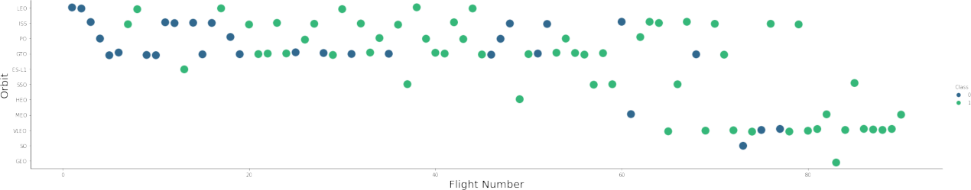
Flight Number vs. Orbit type

Slide 19
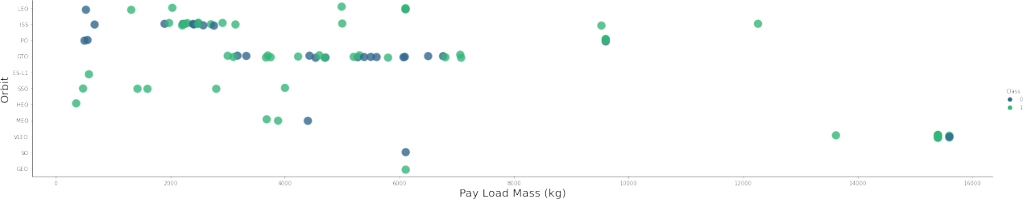
Payload vs. Orbit type

Slide 20
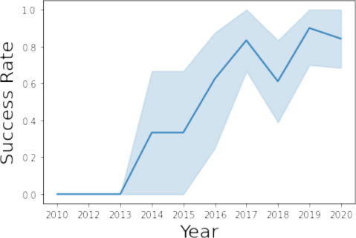
Launch Success Yearly Trend

Slide 21
EDA with SQL

Slide 22
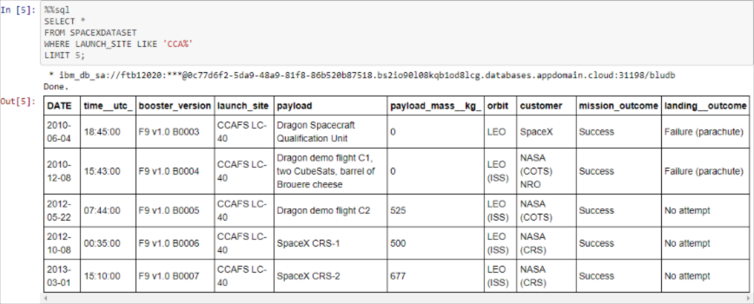
Launch Site Names Beginning with `CCA`

Slide 23
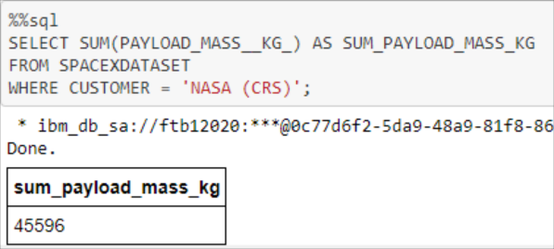
Total Payload Mass from NASA

Slide 24
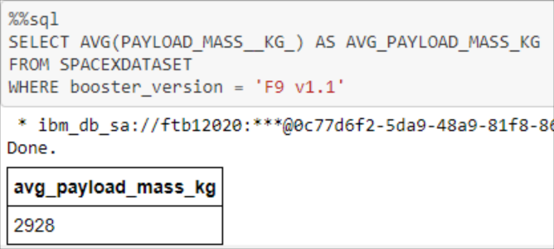
Average Payload Mass by F9 v1.1

Slide 25
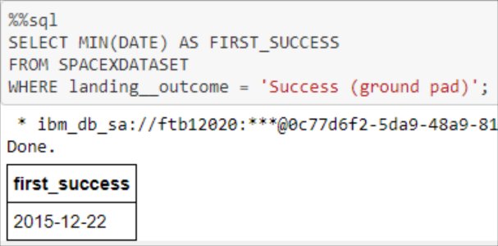
First Successful Ground Pad Landing Date

Slide 26
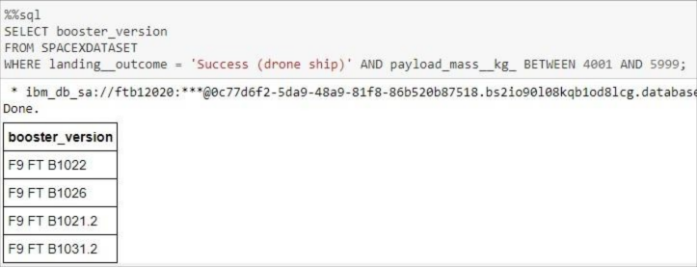
Successful Drone Ship Landing with Payload Between 4000 and 6000

Slide 27
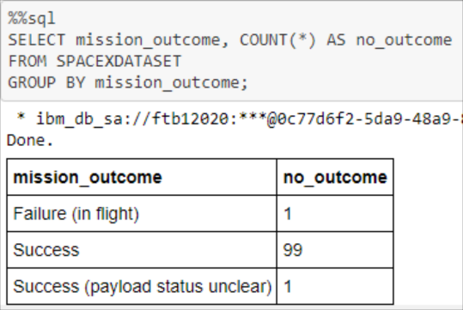
Total Number of Each Mission Outcome

Slide 28
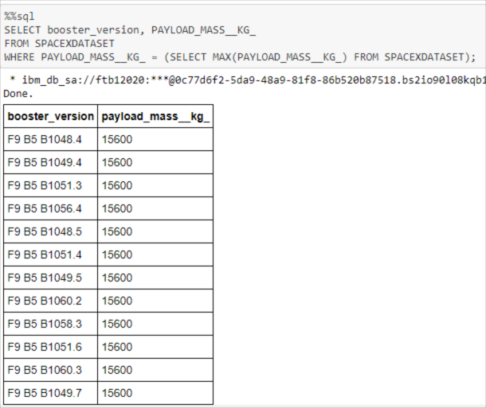
Boosters that Carried Maximum Payload

Slide 29
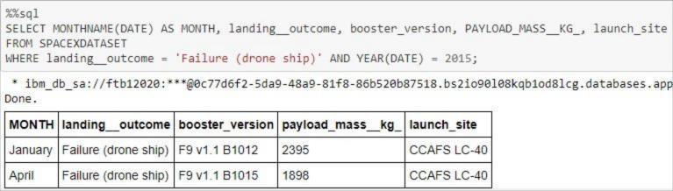
2015 Failed Drone Ship Landing Records

Slide 30
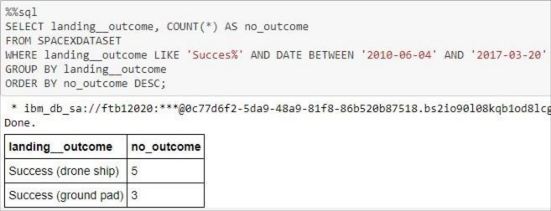
Ranking Counts of Successful Landings Between 2010-06-04 and 2017-03-20

Slide 31
Interactive Launch site analysis with Folium

Slide 32
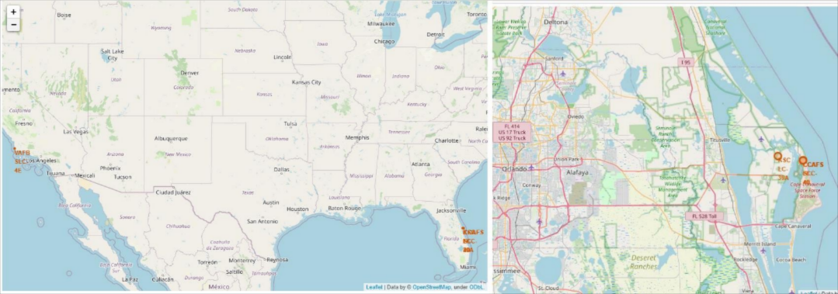
Launch Site Locations

Slide 33
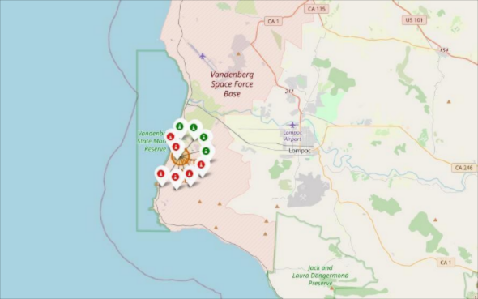
Color-Coded Launch Markers

Slide 34
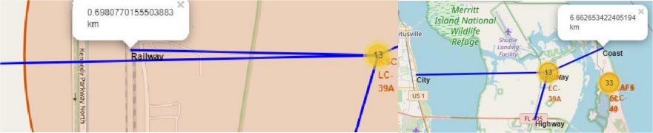
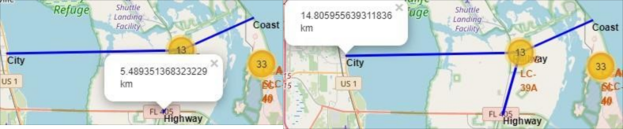
Key Location Proximities

Slide 35
Dashboard with Plotly Dast

Slide 36
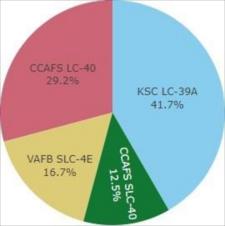

Successful Launch Sites

Slide 37
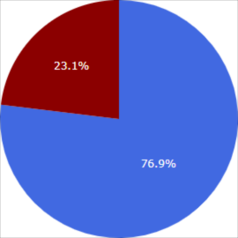

Highest Success Rate Launch Sit

Slide 38
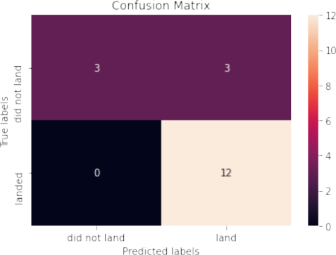
Confusion Matrix

Slide 39
Conclusion
Model Performance: The models performed similarly on the test set with the decision tree model slightly outperforming
Equator: Most of the launch sites are near the equator for an additional natural boost - due to the rotational speed of earth - which helps save the cost of putting in extra fuel and boosters
Coast: All the launch sites are close to the coast
Launch Success: Increases over time
KSC LC-39A: Has the highest success rate among launch sites. Has a 100% success rate for launches less than 5,500 kg
Orbits: ES-L1, GEO, HEO, and SSO have a 100% success rate
Payload Mass: Across all launch sites, the higher the payload mass (kg), the higher the success rate

Slide 40
Appendix
Github link: https://github.com/mathhewRomy/IBM_Data_Science

